Slide 1
Stuart Gallagher
Senior Lecturer, Institute of Education, University of Worcester

Slide 2
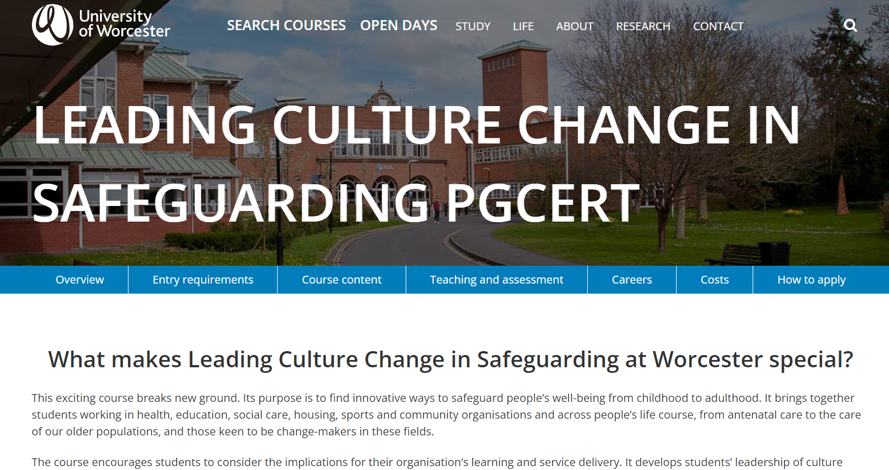

Slide 3
Missing assessment domain
Organisational culture and climate
Professional judgement (situated)

Slide 4
Not either/or but both/and
Doing things right (process) /
Doing the right thing (outcomes)

Slide 5
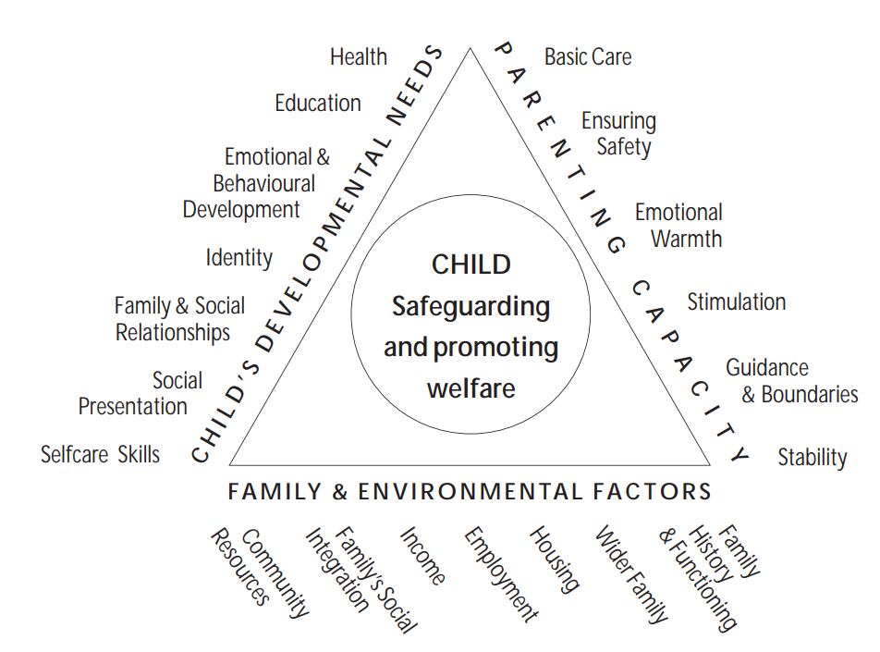
Reference
Department of Health, Department for Education and Employment and the Home Office (2000) Framework for the Assessment of Children in Need and their Families, London, The Stationery Office.

Slide 6
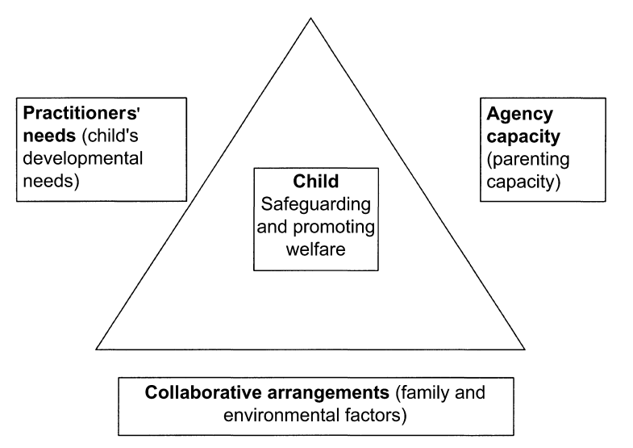
Reference
Horwath, J. and Morrison, T. (2000) ‘Identifying and implementing pathways for organizational change – using the Framework for the Assessment of Children in Need and their Families as a case example’, Child and Family Social Work, vol 5, pp 245-54.

Slide 7
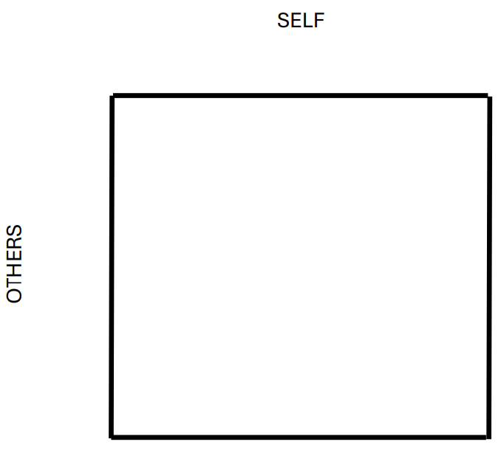

Slide 8
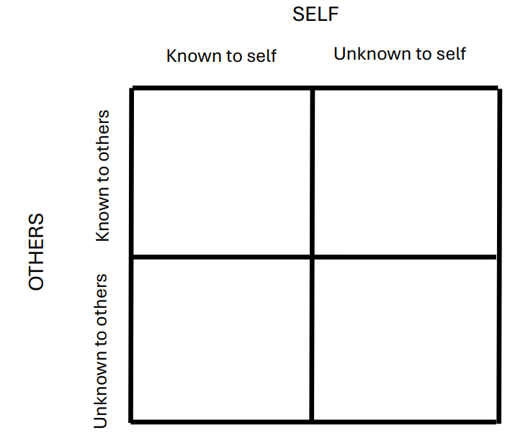

Slide 9
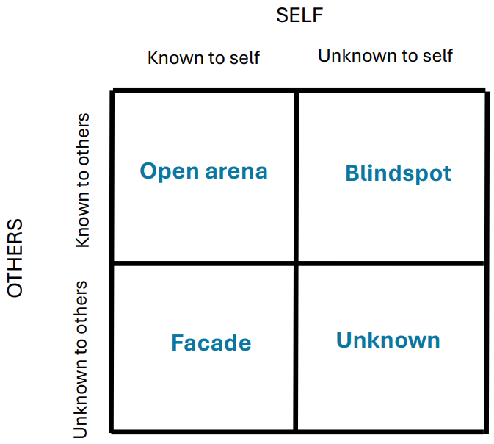

Slide 10
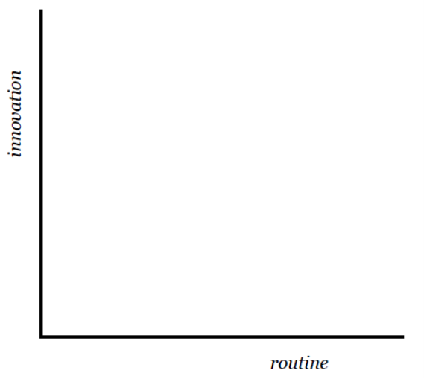
Reference
Bransford, J. et al (2005) ‘Foundations and opportunities for an interdisciplinary science of learning’, in R. Keith Sawyer (ed) The Cambridge Handbook of the Learning Sciences, (chapter 2), Cambridge: Cambridge University Press, pp 19-34.

Slide 11
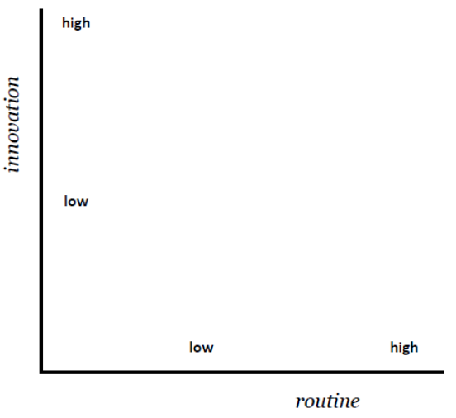
Reference
Bransford, J. et al (2005) ‘Foundations and opportunities for an interdisciplinary science of learning’, in R. Keith Sawyer (ed) The Cambridge Handbook of the Learning Sciences, (chapter 2), Cambridge: Cambridge University Press, pp 19-34.

Slide 12
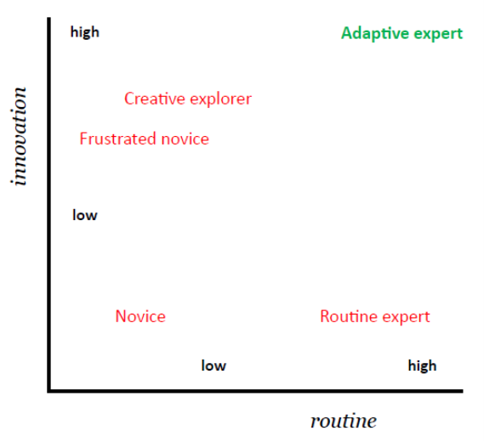
Reference
Bransford, J. et al (2005) ‘Foundations and opportunities for an interdisciplinary science of learning’, in R. Keith Sawyer (ed) The Cambridge Handbook of the Learning Sciences, (chapter 2), Cambridge: Cambridge University Press, pp 19-34.

Slide 13
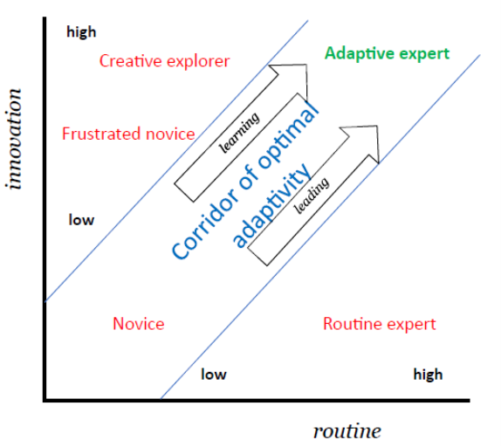
Reference
Bransford, J. et al (2005) ‘Foundations and opportunities for an interdisciplinary science of learning’, in R. Keith Sawyer (ed) The Cambridge Handbook of the Learning Sciences, (chapter 2), Cambridge: Cambridge University Press, pp 19-34.

Slide 14


Slide 15
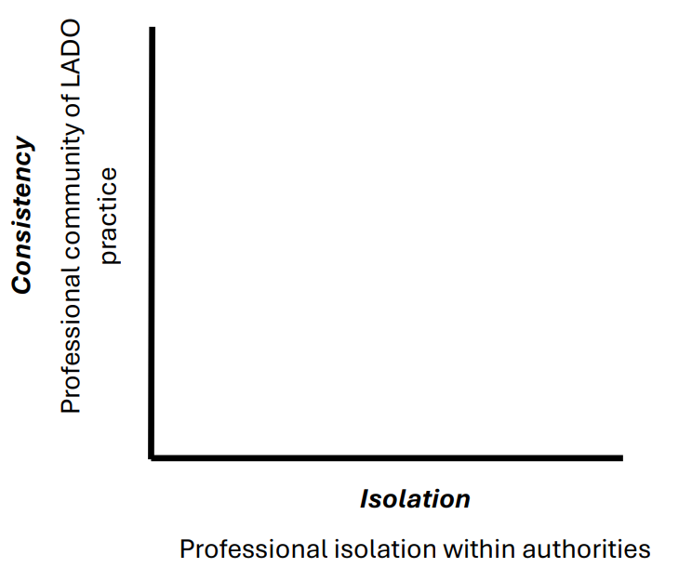

Slide 16
