Slide 1
Graham Smith
Beyond the Whistle- Safeguarding Children and Creating Safer Cultures in Sport.pptx​

Slide 2

Criminal involvement in Children’s Accommodation (West Yorkshire)

Slide 3
Aims / Objectives
Develop joint understanding
Share what works
Share learning

Slide 4
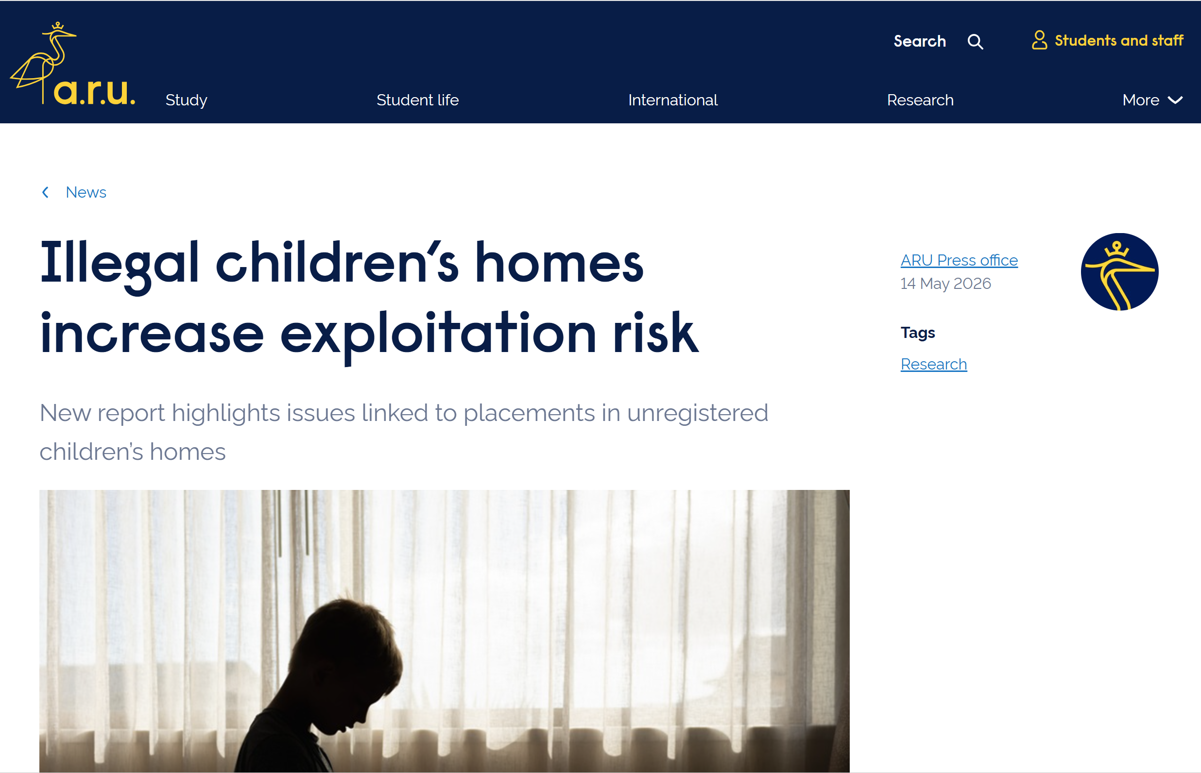
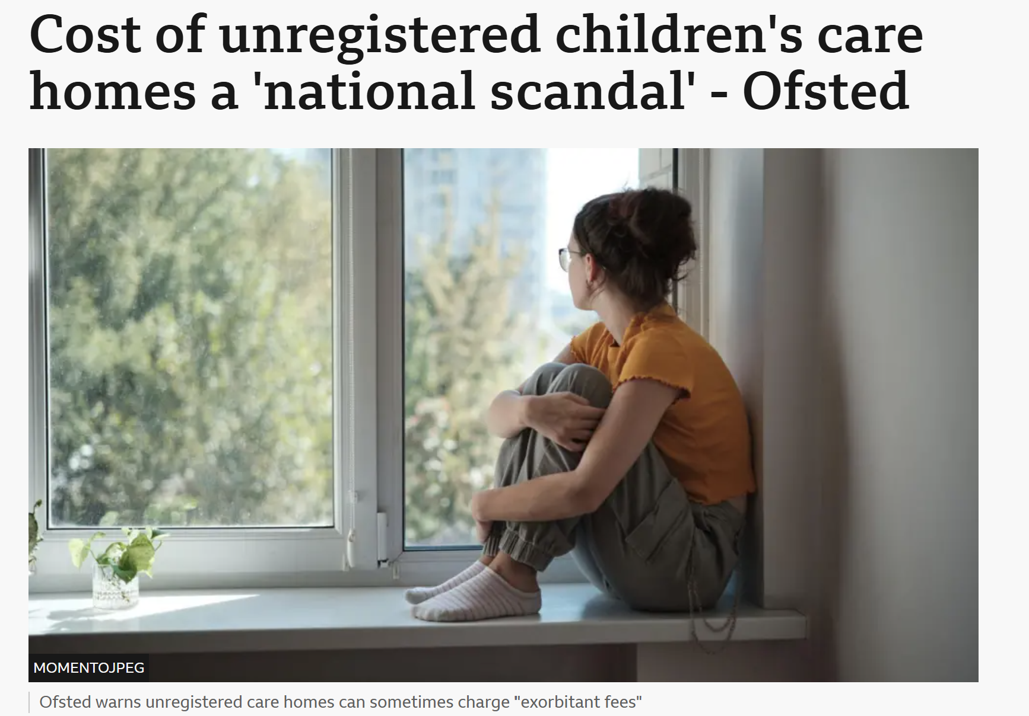
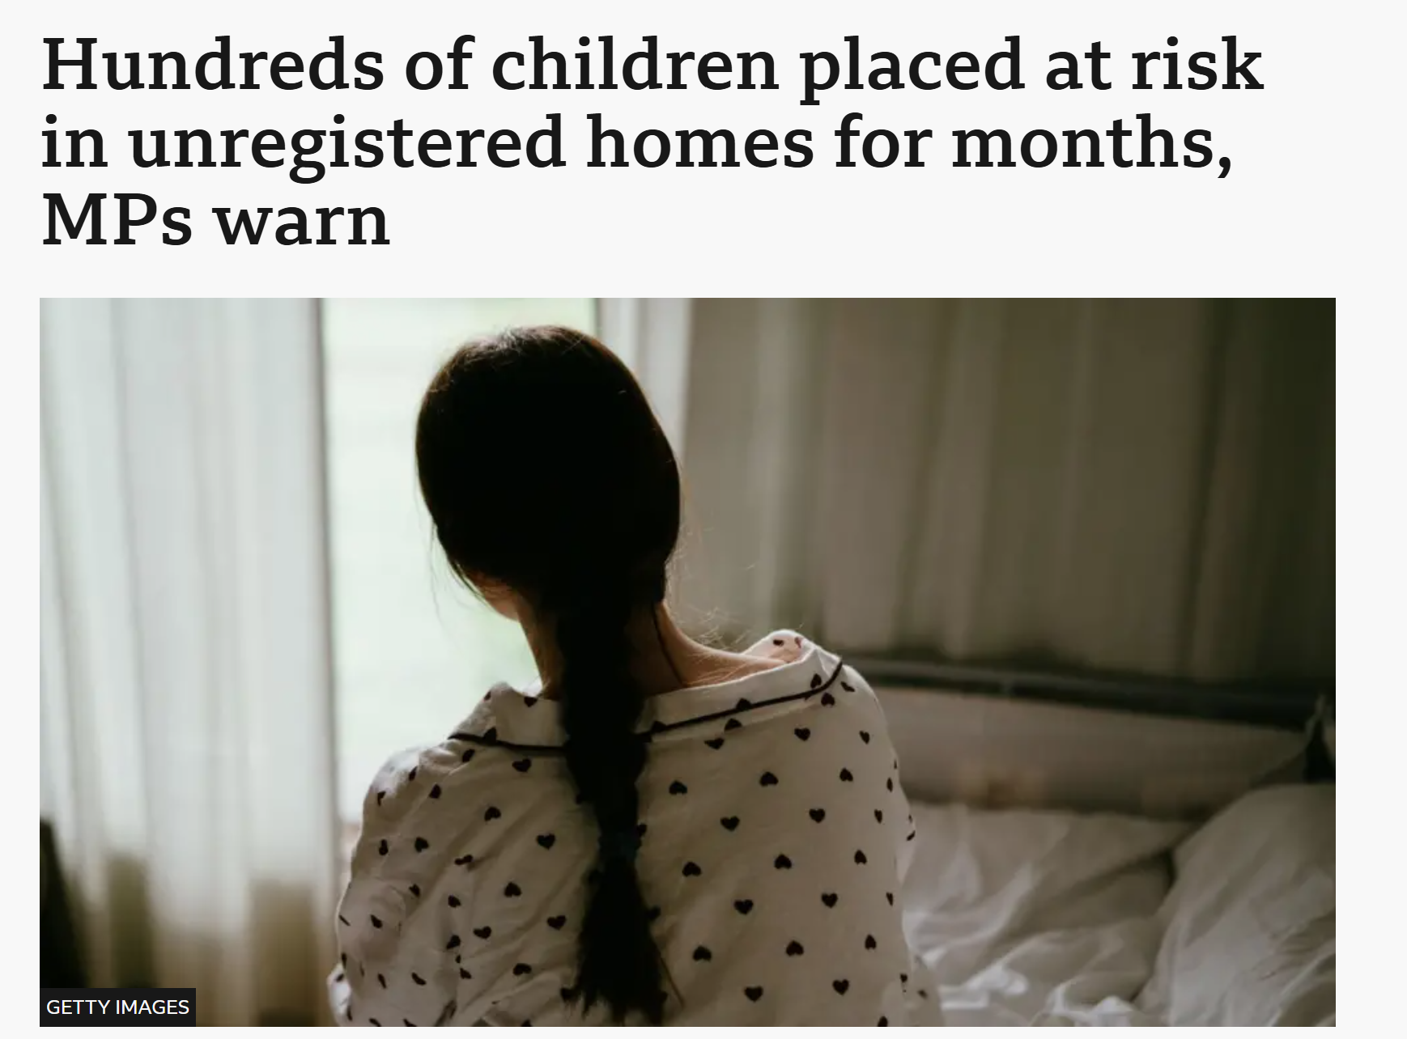
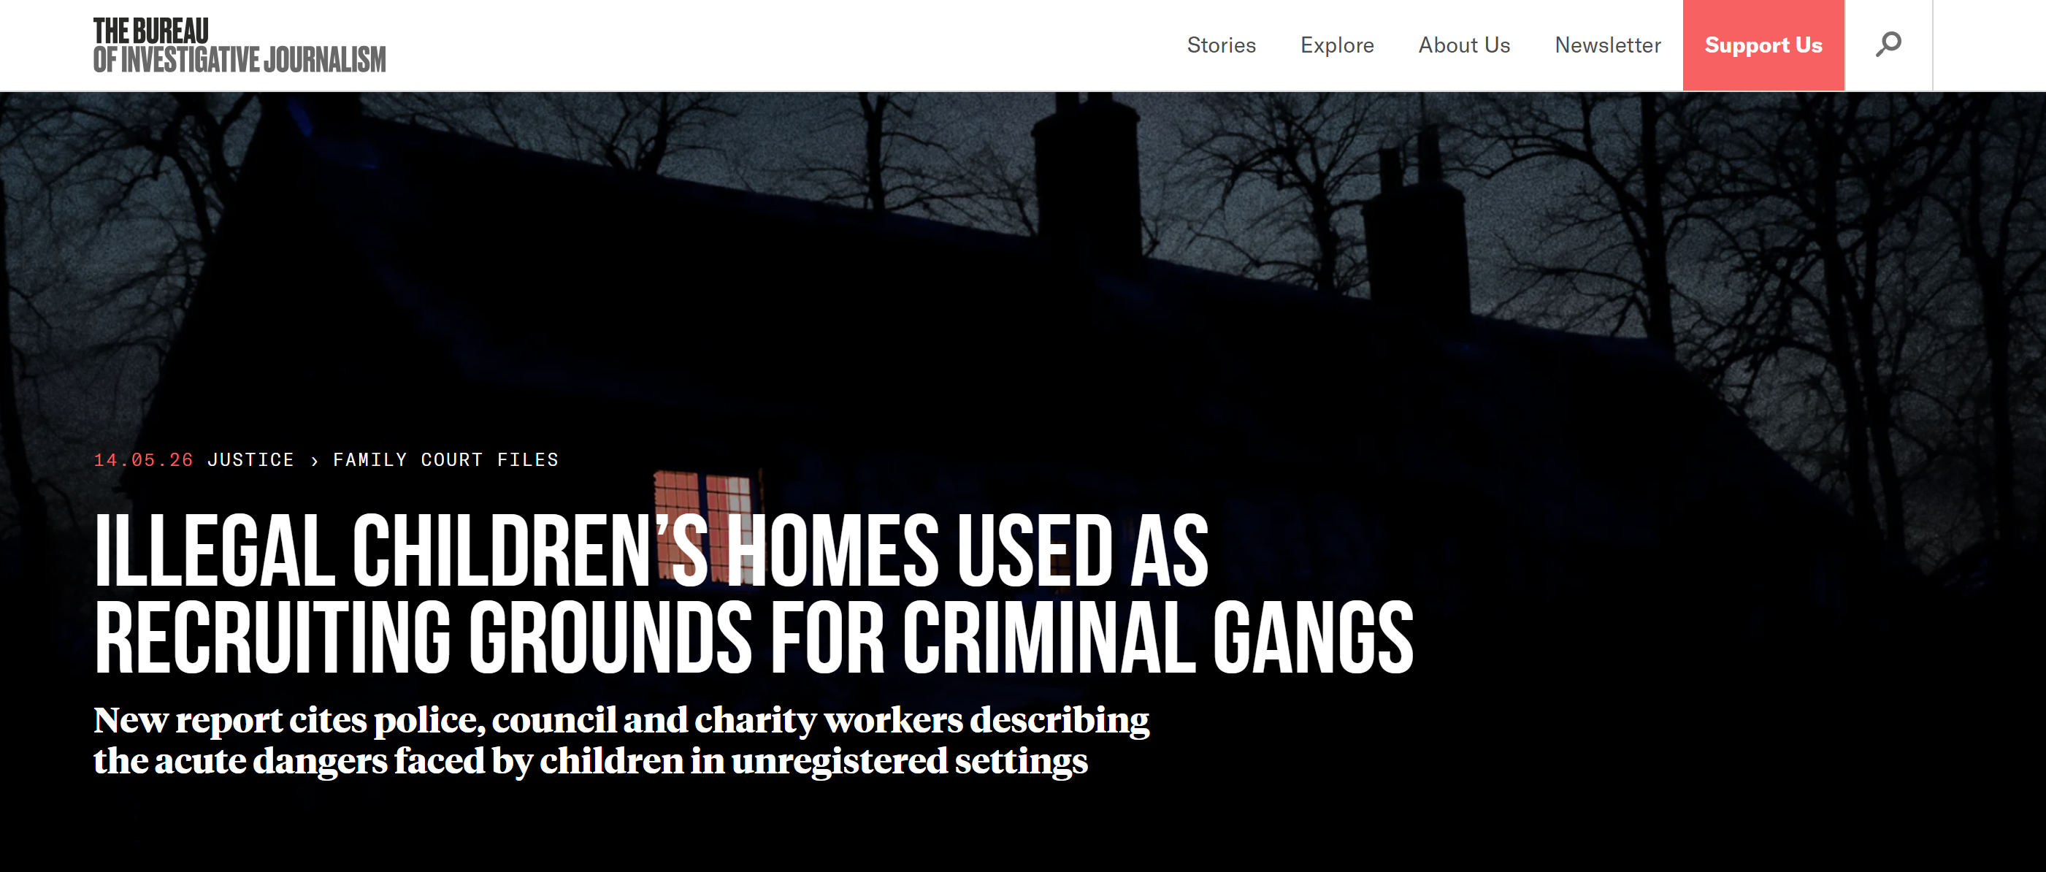
Increased awareness in the Media

Slide 5

Intelligence Assessment
Social workers struck off by Ofsted now working as care home directors
Isolated Examples of Directors and care home workers involved in sexual offences against residents & young people
Isolated Examples of reports of staff working in un-regulated care homes assaulting residents, in addition to ‘lower level’ repeated incidents of bad practice
An example of a Director having associations with people who are subject to a Lifetime Offender Management & Serious Crime Prevention Orders

Slide 6

Intelligence Assessment
Intelligence linking some care home directors to modern slavery, human trafficking and people smuggling
Isolated examples of directors / workers facilitating children working in cannabis farms
Some care home directors involved in money laundering for Organised Crime Groups
Isolated examples of some directors, supplying drugs to care homes and arranging for children in care to sell drugs

Slide 7

Gaps & opportunities
Ofsted / CQC
Data accessibility
Communications & Awareness
LADO
Safeguarding of children in care homes
Information sharing agreements (ISA)
Missing Person Co-ordinators
Intelligence Sharing
Proactive investigation & Enforcement
Governance structures
Designing Out Crime Officers (DOCO) / Planning Process

Slide 8

The Response
Neighbourhood Policing
Care Home Visits
Governance Structure
National & Regional Co-ordination
Locality Assessments Process
Actionable Data / Power BI:
Repeat Missing Locations
Un-registered care home lists
Vulnerability Matrix
DOCO Process
Briefing / training sessions
Monthly District Intelligence Assessments – Co-ordination of enforcement capabilities
Sharing intelligence with Ofsted

Slide 9
Complexities
Intelligence – who owns it? Is it corroborated? malicious? Risk to source vs risk to child
Media – interest in this developing area – potential for mis-information and also for press releases that are not in the interests of children
National Policy / Legislation – has not yet caught up. Limited powers against directors.
Social Care Demand & Capacity - obliged to house children in un-registered settings – potential source of tension

Slide 10
How can you help?
Network / raise awareness of the issues
Bring the right agencies together, including regulatory bodies & develop a shared understanding of risk
Share examples of good practice & learning
Professional challenge - co-ordinate and push for protective action
Highlight cultural & systemic issues, including lower level, repeat incidents

Slide 11

Thankyou!
Robert Brook
DCI Safeguarding Governance Unit
West Yorkshire Police
Robert.brook1@westyorkshire.police.uk

Slide 12
Criminal Involvement in Children’s Accommodation
What do we know?
OFFICIAL SENSITIVE

Slide 13
Identification of Emerging Threat
Merseyside Police Missing Person Co-ordinators
West Yorkshire Police Analysis of Intelligence

Slide 14
What do we Know?
Individuals and directors of companies
Linked to criminality and serious organised crime
Owning or Operating children’s accommodation.

Slide 15
What do we Know?
Some Local Authorities
Placing Children in Unregistered Settings
Inconsistency of Care and Untrained Staff
No Accountability.

Slide 16
Understanding the Risk
The use of unregistered provision remains driven by ongoing challenges in securing sufficient regulated placements
The children's accommodation sector is being identified as a financially lucrative opportunity by some individuals linked to criminality

Slide 17
National Strategic Group
  DfE
  Home Office
  Ofsted
  NPCC
  NCA
  NCVPP

Slide 18
Actions - NSG for Criminal Involvement in Social Care Provision
Complete a National Assessment of Emerging Threat
Review and Strengthen the Ofsted Registration Process
Reduce the use of Unregistered Accommodation
Oversight by the Government - Josh Macalister MP
Develop an Information Sharing Agreement between the NPCC and Ofsted

Slide 19
National Assessment of this Emerging Threat
National Assessments Centre
Assess the Scale
Assess the Motive

Slide 20
NAC - National Threat Assessment
  12 Forces provided data and intelligence
  9 Regions were covered
  6 Forces checked providers in all their Districts
  6 Forces checked providers in one or more Districts but not the entire force

Slide 21
What does the Intelligence Indicate - Scale?
The national picture is varied, with intelligence suggesting a significant proportion of children’s accommodation in some areas being affected, whilst much smaller percentages in other areas.

Slide 22
Likely Motivation
  Financial Gain
  Modern Slavery
  Money Laundering
  Drug Dealing/ Trafficking
  Tax Evasion
  Fraud

Slide 23
National Assessment of this Emerging Threat
Most Placements continue to provide Safe and Appropriate Care
No Intelligence that Criminal or Sexual Exploitation of Children is a Primary or Secondary Motive
Isolated Incidents of Providers using Children for Drug Dealing

Slide 24
Information Sharing Agreement
Clarify what information and intelligence can be shared by forces with Ofsted
Recommend the process for responding to requests for information from Ofsted
Recommend the process for police proactively sharing intelligence with Ofsted
Provide clarity on what Ofsted can do with the information supplied.

Slide 25
Implications for Safeguarding Partnerships
  Placement Challenges should be Recognised as a Safeguarding Threat
  Information and Intelligence should be Proactively Shared and Developed
  There needs to be clearer oversight of provision.
  There needs to be co-ordinated disruption of risk environments

Slide 26
Unregistered Provision
  Since Autumn 2025, DfE has taken action to reduce the use of Unregistered Provision
  Ofsted Powers Strengthened through the Children’s Wellbeing and School’s Act 2026
  Developing a National Dataset on Unregistered Placements.
  DfE working with Local Authorities to reduce Reliance on Crisis Placements

Slide 27
Improving Placement Sufficiency
  Home Again Programme
  Increase Availability of Safe, Registered Provision
  Regional Care Co-operatives
  Families First Programme

Slide 28
CSC Market Reform
  Tackling Excessive Profits
  High-Quality Care at a Fair Price
  Greater Transparency
  Cap Provider’s Profits

Slide 29
Implications for LADO’s
  Raise Awareness amongst Professionals
  Ensure information is shared appropriately.
  Respond to Allegations against anyone Working Directly with Children
  Convene and Chair Inter-agency Discussions

