Slide 1
Alex Hepton
https://prezi.com/view/1R7vBWDqZSsbaf4BXLNV/

Slide 2
Safeguarding in Grassroots Football
Suitability, Transferrable Risk and Effective LADO Partnership

Slide 3
Workshop Outline
A shared Understanding of safeguarding realities in grassroots football
How The FA considers suitability and transferrable risk
How information sharing can strengthen decision making
Notes:
Grassroots football accounts for 62% of referrals and 77.8% of cases opened.
63% of referrals related to concerns outside football

Slide 4
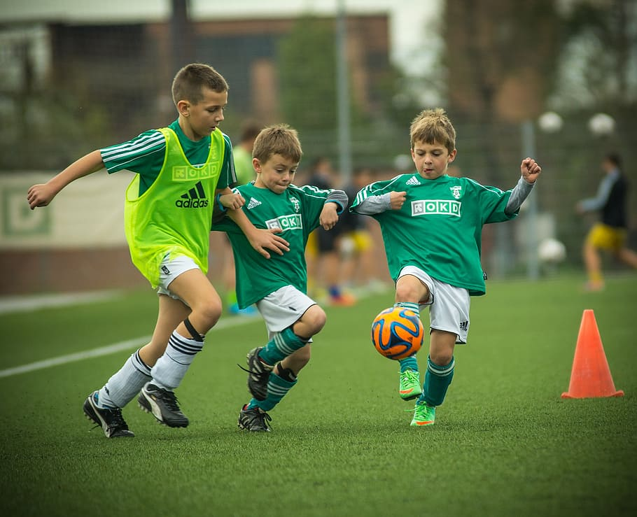
Safeguarding Challenges in Grassroots Football
Scale & Variation
Volunteer Workforce
Multiple Roles & Settings
Informal Culture
Community Relationships
Fragmented Intelligence
Mobility
Differing Thresholds & Purpose
Children’s Voice & Power
Digital Reach
Notes:
Key features that can complicate safeguarding
Scale and variation: clubs differ significantly in size, governance, resources and safeguarding confidence.
Volunteer workforce: many roles are unpaid, turnover can be high, and safeguarding expertise may sit with one welfare officer carrying competing responsibilities.
Multiple roles and settings: an individual may coach, officiate, sit on a committee and work across several clubs or age groups, increasing access and complicating oversight.
Informal culture: blurred boundaries can arise through lifts, changing rooms, social media, messaging apps, and contact outside organised activity.
Community relationships: family networks, local reputation and loyalties may inhibit reporting, create conflicts of interest or lead to minimisation.
Fragmented intelligence: separate concerns may appear low-level in isolation but indicate a pattern when information from clubs, employers, the LADO, police and The FA is brought together.
Mobility: a person may move between clubs, counties, age groups or sports, particularly after informal action that has not been recorded or shared.
Different thresholds and purposes: criminal, employment, LADO and sports-regulatory processes answer different questions and may reach different outcomes on the same facts.
Children’s voice and power: selection, playing time, progression and belonging can make it difficult for a child or parent to challenge a respected adult.
Digital reach: online contact can extend access beyond training and matches and can connect conduct in a person’s private life to their football role.

Slide 5

Managing Suitability Concerns in Football
Exercise:
Read the fictional scenario and prepare a reasoned partnership response.
Distinguish clearly between a suitability concern, evidence of transferable risk, the opportunity associated with a football role, and the remit of each organisation.

Slide 6
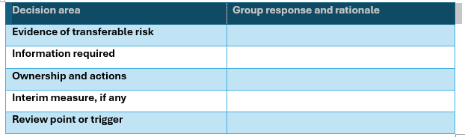
Discussion Questions
tate whether the information currently reaches The FA SCMT threshold and identify the evidence and reasoning that supports your view.
Does the information currently reach The FA SCMT threshold?
What evidence and reasoning supports your view.

Slide 7
The Role of the County FA DSO
CFA safeguarding contact: local point of contact for Club and League Welfare Officers, providing advice, support and oversight and promoting safe practice across grassroots football.
Manages low-level concerns: Addresses behaviour that does not meet the threshold for referral to The FA
Undertakes bespoke work: Where SCMT threshold is not met, in conjunction with The FA, agrees tailored work with the individual on issues such as boundaries, communication, conduct, supervision, transport or emotional regulation
Escalates when required: Refers to The FA SCMT & Statutory agencies
Notes:
Core principle: A proportionate response that is fair to the individual while prioritising the safety and wellbeing of children and adults at risk.

Slide 8
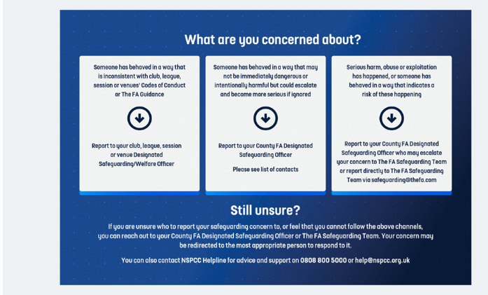
Reporting Concerns in Football

Slide 9
The FA SCMT
Initial assessment: considers jurisdiction, threshold, known history, football role, access and whether an interim safeguard may be required.
The FA’s safeguarding investigation: is separate from employment, disciplinary & criminal processes, although the evidence and outcomes from those processes are relevant
Final assessment: is evidence-based, balanced and considers both risk and mitigating factors. The standard applied is the balance of probabilities when assessing transferable risk.
The individual: is given a meaningful opportunity to engage and provide their account, and the child’s or adult at risk’s voice should be incorporated.
Final recommendations: may be considered by an independent Safeguarding Review Panel.
Notes:
Core function to investigate and assess allegations and concerns about individuals who may pose a risk of harm to children and/or adults at risk in affiliated football, and to put safeguards in place where necessary.

Slide 10
The FA Safeguarding Regulations
3.1 (Notification that an individual has been charged with an Offence)
3.2 (Notification that an individual is the subject of an investigation by the Police, Children’s Services or any other authority relating to an Offence)
3.3 (Any other information which causes The Association reasonably to believe that a person poses or may pose a risk of harm to a child or children),
4.1.1 (Whether a child is or children are or may be at risk of harm)
4.1.2 (Whether the matters are of a serious nature).
Notes:
Talk to Safeguards:
Investigation Only
Interim Suspension from All Football not/including Playing
Interim Suspension from U18 Football not/including Playing
Supervision Deed

Slide 11
Assessing Transferrable Risk
Exercise:
For each scenario, groups should identify:
What may transfer into football
(2) What information gaps exists
(3) Who should share what, with whom and when
(4) Proportionate interim safeguards

Slide 12
A structured transferable-risk lens
Assessment area | Questions considered
Nature and seriousness | What is alleged? What type of harm, behaviour or concern is involved? Is there escalation, persistence, planning or exploitation?
Evidence and outcome | What information is available from the child, LADO, employer, police, social care, witnesses and the individual? What was found, not found, or left unresolved?
Football role and access | What roles does the person hold or seek? Which age groups or adults at risk can they access? Do they have authority, trust, one-to-one contact, transport, overnight or digital access?
Transfer mechanism | Could the behaviour, attitudes, patterns, vulnerabilities or circumstances recur in football? Does the football role provide comparable opportunity, power or access?
Pattern and history | Are there previous referrals, DBS content, llc, complaints, disciplinary matters or movement between settings? Do separate concerns become significant when viewed together?
Insight and response | Does the person acknowledge the concern, understand its impact, cooperate, demonstrate learning and sustain safer behaviour? Are explanations consistent with other evidence?
Protective and aggravating factors | What reduces or increases risk? Supervision, role restrictions, training, support, stability, compliance, secrecy, denial, access and changes in circumstances.
Child and adult-at-risk impact | What is known about the experience of the child or adult at risk? How can their voice inform the assessment without placing responsibility on them?
Proportionality and manageability | Can identified risk be safely managed at a local level? Is restriction from football necessary? What safeguards are realistic and capable of monitoring?
Notes:
Key distinction: “No further action”, “unsubstantiated” or “no criminal charge” does not automatically mean “no transferable risk”. Equally, the existence of an allegation does not establish risk. The task is to examine the underlying information, its reliability and relevance to the person’s current or potential football role and risk in that environment.

Slide 13
Effective partnership
Information that supports a proportionate assessment
Precise allegation/concern, dates, settings and individual’s role.
Child’s account and impact, together with any relevant contextual information.
Chronology, patterns, previous concerns and any action or advice already given.
Status and anticipated timescale of police, social-care, LADO, employment or regulatory processes.
Findings, rationale and source material where it is lawful, relevant, necessary and proportionate to share.
Known football involvement, including multiple clubs, counties, roles, age groups and digital contact.

Slide 14
Shared partnership working
Distinguish: LADO outcome, employer decision & The FA’s assessment of risk in football, and who owns each decision.
Contribute: each agency provides its evidence, expertise and analysis rather than expecting the LADO to generate the outcome in isolation or another agency to adopt its conclusion.
Share reasoning: communicate what is established, disputed, untested or unavailable, the weight given to the information and the rationale for the professional view.

Slide 15
Test differences openly: identify whether they reflect different evidence, thresholds, statutory or regulatory remits rather than failure to cooperate.
Avoid circular decision-making: The FA should not determine the LADO outcome, and the LADO outcome should not be treated as a substitute for The FA’s own football-risk assessment.
Close the loop: at outcome, confirm the agreed LADO position, each agency’s separate decision, any remaining uncertainty, what can be shared, required action, & responsibility for communicating change.
Notes:
The LADO agrees the allegation outcome, informed by the evidence, professional views and analysis provided by all relevant agencies.
• The FA does not determine whether the allegation is substantiated for the purposes of the LADO allegations-management process.
• The FA makes a separate regulatory assessment, on the balance of probabilities, of whether the individual poses a risk of harm in affiliated football and whether action is needed under The FA’s rules and regulations.
• The two decisions should inform each other, but neither replaces or predetermines the other.

Slide 16
Take Aways
Grassroots football’s scale, informality and mobility can magnify small gaps in information or oversight.
Conduct outside football can be relevant when the behaviour, opportunity, access or underlying risk may transfer into a football role.
Different agencies can legitimately reach different decisions because their remit, evidence and threshold are different.
Good assessments depend on the underlying information, chronology and rationale—not only an outcome label.
Early, purposeful liaison helps protect children, preserves investigations and supports fair, proportionate decisions.

Slide 17
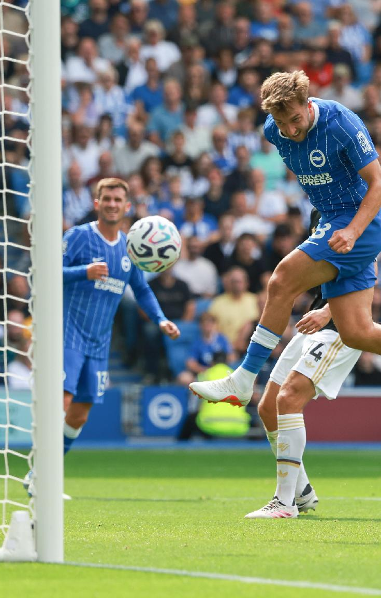
Safer Recruitment Practices for Host Families
Rebecca Waller

Slide 18
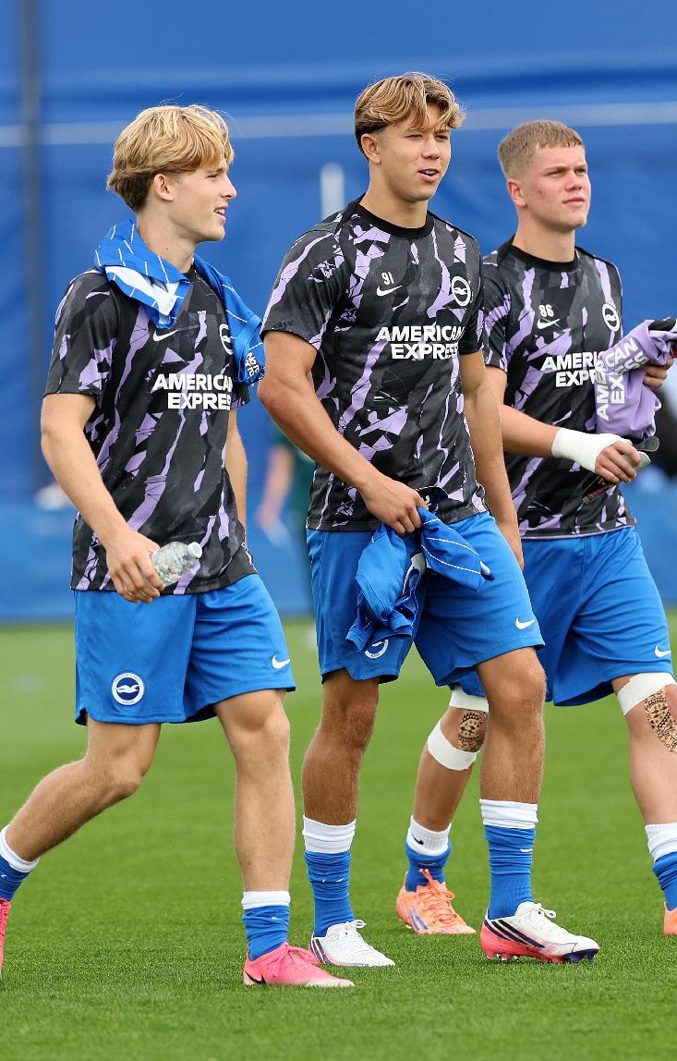
Why We Need Hosts
Becoming an elite athlete takes commitment, hard work and a dedication to a rigorous lifestyle. However, being an elite young athlete require more than physical training; a stable host home offers emotional support, safety, and guidance through high-pressure career moments.
Scholars
16 and 17-year-old male scholars residing full-time during their 2-year scholarship.
Schoolboys
U13–U16 players attending day release, staying 1–2 nights per week during term time.
Trialists
Domestic and international players on short-notice stays ranging from 2 days to 2 weeks.
Girls Academy Players on full or part-time schedules based on individual commitments.
Notes:
Holistic Development: Emphasize that elite young athletes require more than physical training; a stable host home offers emotional support, safety, and guidance through high-pressure career moments.
Flexibility Requirements: Explain how host households accommodate diverse scheduling needs across trialists, schoolboys, and full-time scholars throughout the football season.
Yearly Football Cycle:
Seasonal operation with a mandatory pre-season host induction evening and ongoing workshops.
Placement breaks aligned with match schedules, international duty, Christmas break (supported by host retainers), and end-of-season hiatus.
Who We Host
Trialists
Domestic and international young players on short-notice stays ranging from 2 days to 2 weeks.
Schoolboys: U13–U16 players attending day release, staying 1–2 nights per week during term time.
Scholars: 16 and 17-year-old male scholars residing full-time during their 2-year scholarship.
Women's & Girls Academy: Players on full or part-time schedules based on individual commitments.

Slide 19
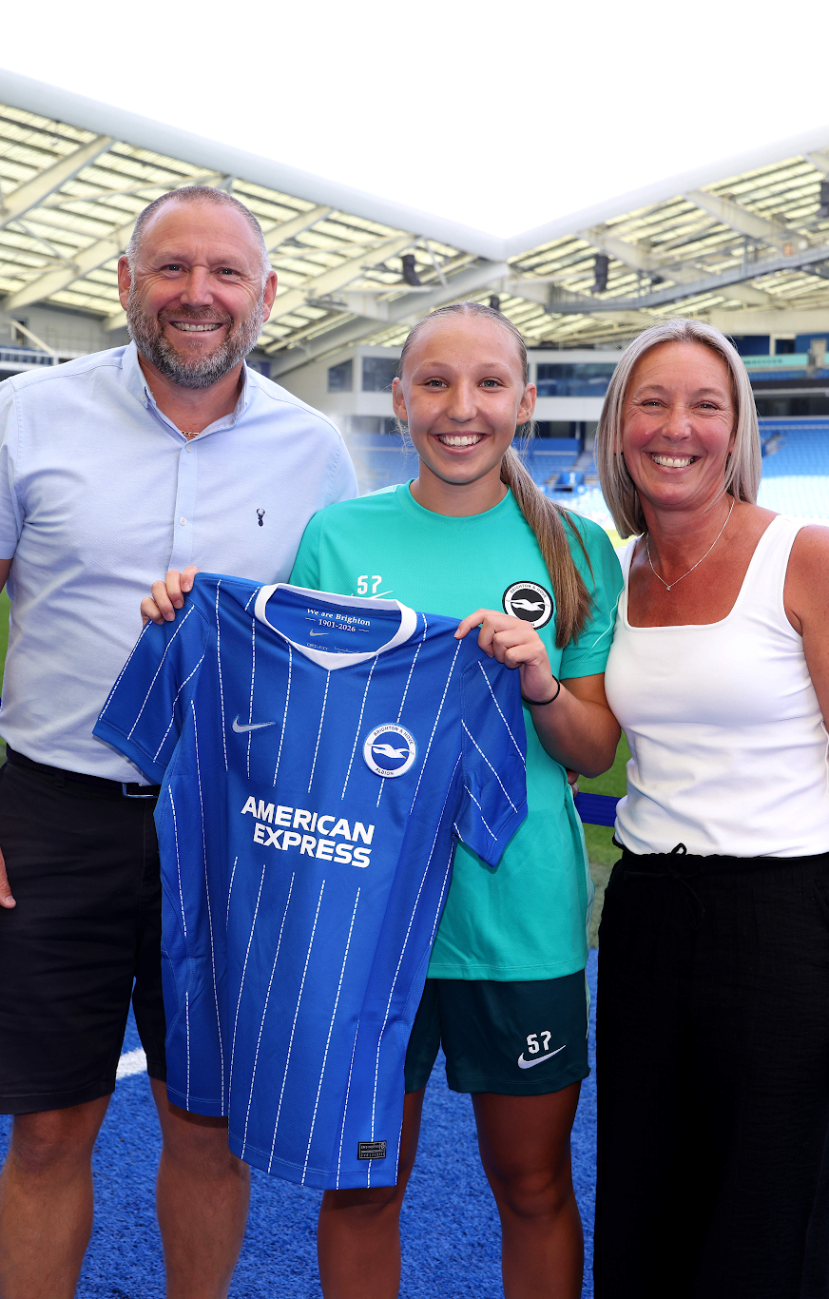
47 Players Across 35 Households
Boys Academy (U13-U18)
14 Scholars
2 Full-time schoolboys (Private Fostering)
22 Part-time schoolboys
Girls Academy (U19 Only)
5 Full-time
4 Part-time
Other
7 trialists & 13 holiday cover placements July-September 26
46 active hosts
15 applications in progress
2026/2027 Season Host Remuneration Structure:
Full-Time Rate: £197 per week
Part-Time Rate: £35 per night
Private Fostering Rate: £216 per week
Christmas Break Retainer: 50% rate over the
2-week break for full-time placements
Dietary Supplement: £10 p/w

Slide 20
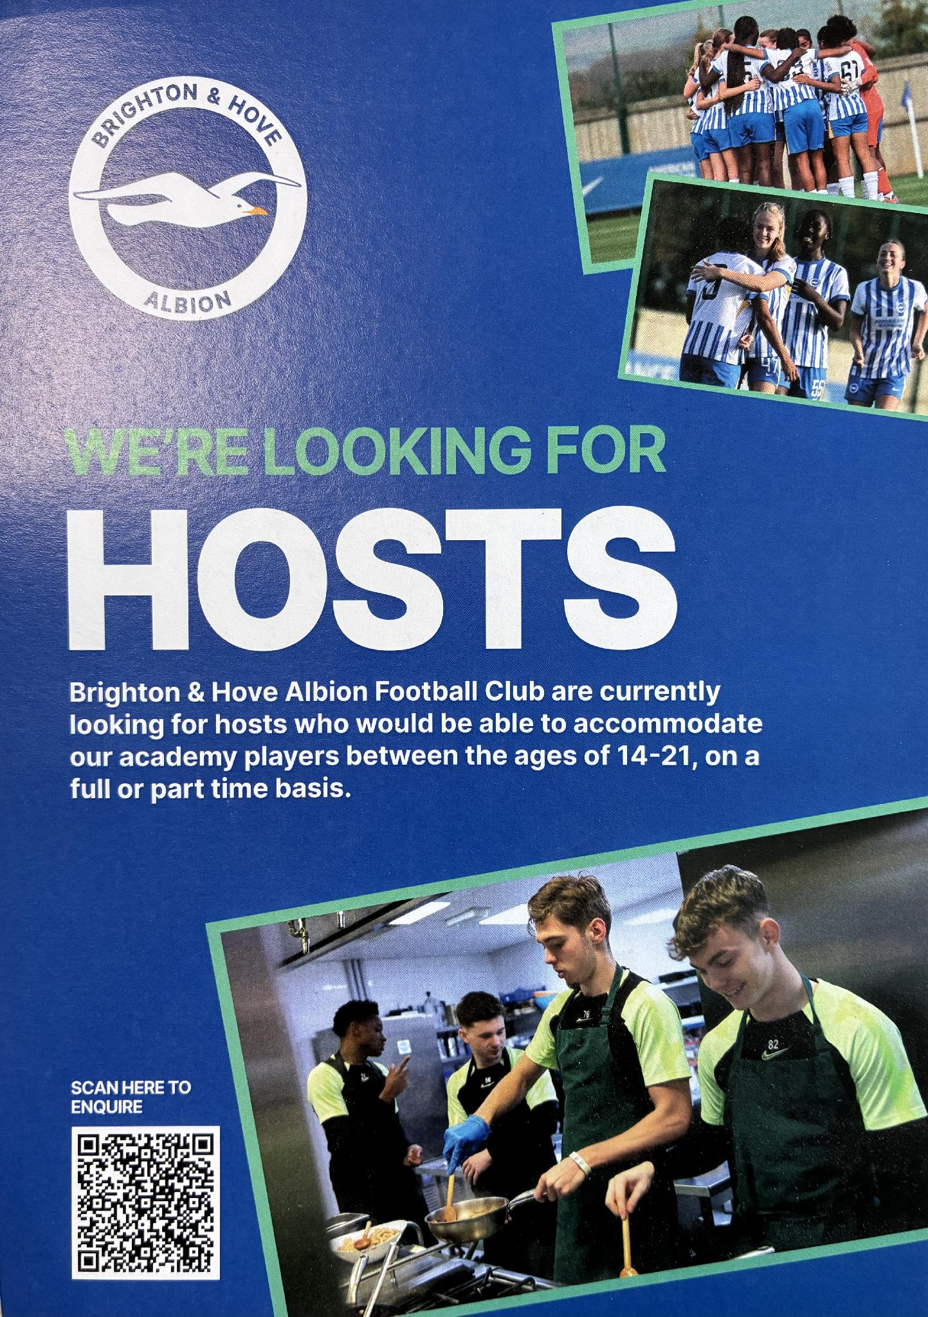
HOW WE RECRUIT
Word of mouth
Targeted social media adverts
Leaflet drop in local area
Adverts in local schools
Notes:
Quality Over Quantity: Emphasize that recruitment targets hosts capable of providing a stable family environment rather than simple lodging.
Expectation Setting: Detail how initial recruitment conversations clearly outline the demands of elite youth sports, including strict curfews and anti-doping regulations.

Slide 21
Assessment: Start to Finish
Initial Application & Screening
First home visit
Second home visit
Health & Safety Inspection
Panel
Induction & onboarding, including safeguarding training
Start DBS, referencing & LADO checks
Pet Assessment
Notes:
Step-by-Step Assessment Process:
Initial Inquiry & Application: Basic eligibility and household composition mapping.
Home Visit & Property Audit: Verifying private room setup, heating, hygiene, communal access, and safety standards.
Vetting & Background Checks: Enhanced DBS checks for all household members aged 16+, character references, and local authority checks.
Multi-Agency & Safeguarding Panel Approval: Formal sign-off by the Safeguarding and Player Care Team.
Induction Onboarding: Mandatory pre-season training prior to any player placement.
Talking Points
Rigorous Safeguarding: Reassure the LADO that every household member over 16 undergoes thorough checks before host approval.
Environmental Standards: Explain that physical home visits ensure facilities meet living, study, and recovery standards required for youth welfare.

Slide 22
Assessment: Start to Finish
Initial Application & Screening
First home visit
Second home visit
Health & Safety Inspection
Panel
Induction & onboarding, including safeguarding training
Start DBS, referencing & LADO checks
Pet Assessment

Slide 23
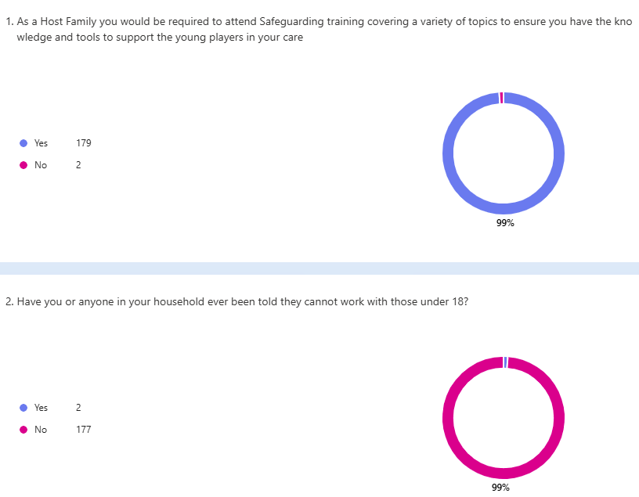

Assessment: Start to Finish
Considerations
Motivation for hosting
Any immediate red flags?
Initial Screening Criteria
  Commitment to nurturing young elite athletes and adhering to Team Brighton values
  Capacity to offer appropriate private rooming (single, double, or twin as agreed) and access to shared living spaces.
  Willingness to undergo full safer-recruitment vetting and mandatory ongoing training
Initial Application & Screening

Slide 24
Assessment: Start to Finish
Initial Application & Screening
First home visit
Initial Application & Screening
First home visit
Second home visit
Health & Safety Inspection
Panel
Induction & onboarding, including safeguarding training
Start DBS, referencing & LADO checks
Pet Assessment

Slide 25
Assessment: Start to Finish
First home visit
Why do you want to host and why will you be good at it?
Who lives in the household/who is a regular visitor?
Hosting experience?
Understanding of elite sport?
Safeguarding understanding?
Experience of caring for children?
What might you find difficult?
What are your experiences of being parented?
How would you support the identity of a child in your care?
Family & household functioning
Household rules
General feel of the property
Known to LA? Opportunity to share reasons they may not be able to host
Consider delays
Start DBS, referencing & LADO checks
Start DBS, referencing & LADO checks

Slide 26
Assessment: Start to Finish
First home visit
First home visit
Second home visit
Initial Application & Screening
Second home visit
Health & Safety Inspection
Panel
Induction & onboarding, including safeguarding training
Start DBS, referencing & LADO checks
Start DBS, referencing & LADO checks
Pet Assessment

Slide 27
Assessment: Start to Finish
Second home visit
If your player is not home in time for their curfew, what would you do?
If the player tells you they are feeling unwell while in your care, how would you respond and what actions would you take?
If a situation arises where the player is upset, uncomfortable, or discloses a concern, how would you handle this and who would you report it to?
A player challenges a comment made in your home that they feel is discriminatory. How would you respond?
How would you respond to a player asking for a friend to visit, in the day time and then also overnight?
What boundaries would you have around mobile phones, gaming, and social media?
Predominantly dogs
Pet Assessment
Pet Assessment

Slide 28
Assessment: Start to Finish
First home visit
Second home visit
Second home visit
Health & Safety Inspection
Initial Application & Screening
Health & Safety Inspection
Panel
Induction & onboarding, including safeguarding training
Start DBS, referencing & LADO checks
Pet Assessment
Pet Assessment

Slide 29
Assessment: Start to Finish
Health & Safety Inspection
Gas Safety Certificate
Carbon monoxide detector
Smoke Alarms
Fire Extinguisher/ blanket
Risk assessment & recommendations
Notes:
Risk Assessment form
- Fire hazard

Slide 30
Assessment: Start to Finish
First home visit
Second home visit
Health & Safety Inspection
Health & Safety Inspection
Panel
Initial Application & Screening
Panel
Induction & onboarding, including safeguarding training
Start DBS, referencing & LADO checks
Pet Assessment

Slide 31
Assessment: Start to Finish
Attendees
1 Chair, Senior Safeguarding Professionals independent of Performance & Wellbeing team and assessment process.
2 panel members from the club with varying roles and independent of assessment process to this point.
Panel
How would you manage a situation where your own child’s needs conflict with those of the player you are hosting? E.g. A player receives more attention or opportunities than your child and this causes tension at home.
You are hosting a player with a different cultural background to yourself and your family. Do you think you could accommodate their needs as an individual, and how might you do this?
Can you explain the style you would adopt to respond to challenging behaviour from a player in your home?
A player tells you they don’t feel safe at the club but asks you not to tell anyone. What do you do?
Notes:
Advise on suitability to host

Slide 32
Assessment: Start to Finish
First home visit
Second home visit
Health & Safety Inspection
Panel
Panel
Induction & onboarding, including safeguarding training
Initial Application & Screening
Induction & onboarding, including safeguarding training
Start DBS, referencing & LADO checks
Pet Assessment

Slide 33
Assessment: Start to Finish
Transition to active host
Host contract
Confidentiality agreement
Safeguarding training
Induction & onboarding, including safeguarding training

Slide 34
Assessment: Start to Finish
Initial Application & Screening
First home visit
Second home visit
Health & Safety Inspection
Panel
Induction & onboarding, including safeguarding training
Start DBS, referencing & LADO checks
Pet Assessment

Slide 35
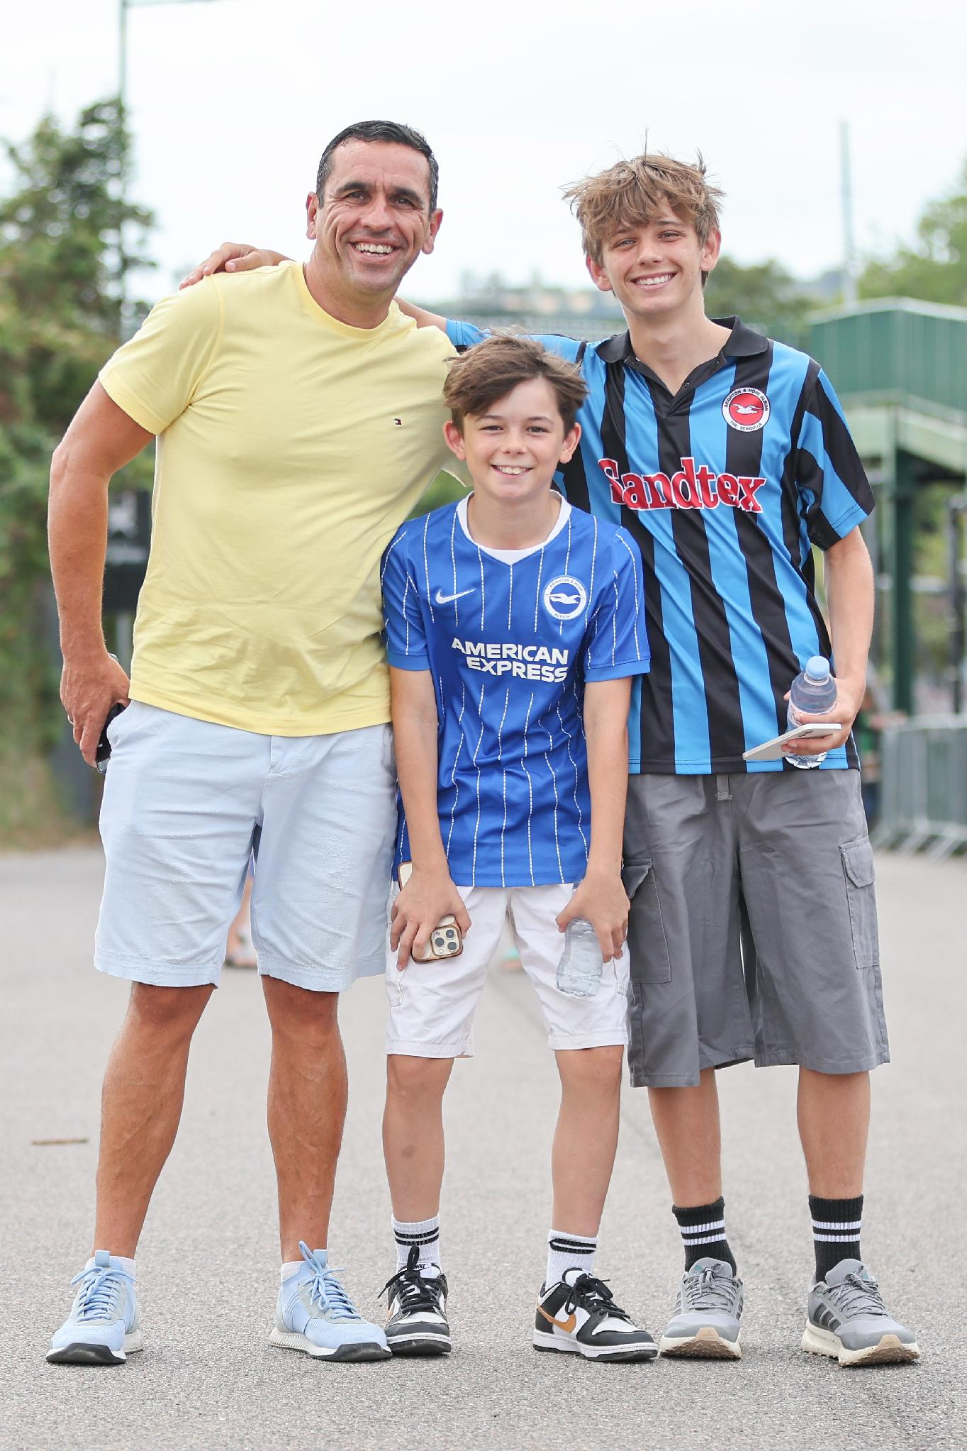
Matching and placement plans
Homestay information form completed by player’s parent/guardian
Collate special requests, medical info etc.
Matching process
Contact proposed host Contact player’s parent/guardian
Confirmation email
Player’s parent/guardian and host have direct contact to arrange visit
Player provided with homestay info sheet
Placement plan completed prior to stay commencing
Player to agree to homestay contract prior to starting placement
Local Authority notified if placement is a Private Fostering arrangement
Notes:
Talking Points
Proactive Monitoring: Emphasize that monitoring is ongoing and preventative rather than reactive.
Player Voice: Explain how player feedback is gathered independently to ensure they feel safe, respected, and valued in their placement.

Slide 36
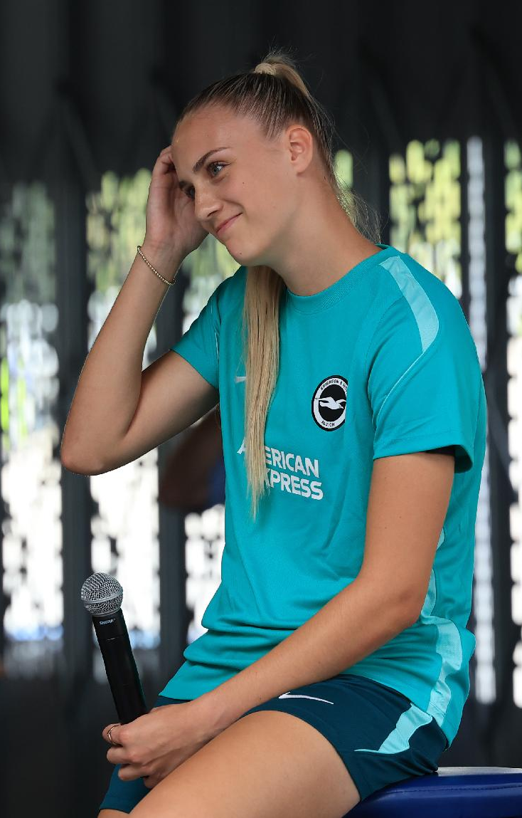
ANNUAL REVIEW & MONITORING
2 x unannounced visits per host (full time) per season
1 x pre-arranged revisit per season
Updated photos of accommodation
Player/Guardian feedback
Host feedback
Club feedback
Annual panel
Recommendation decision

Slide 37
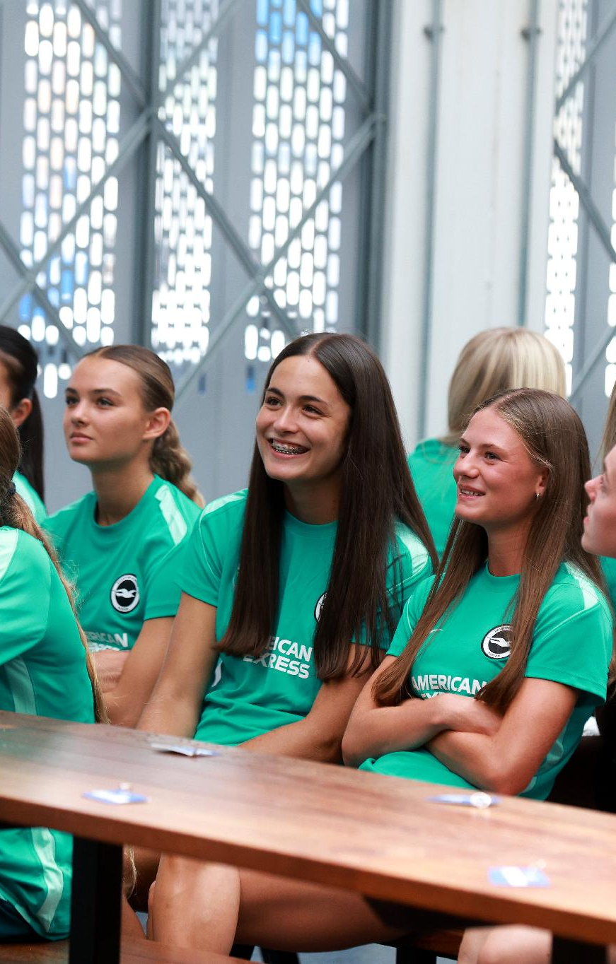
SUPPORT & TRAINING
Mandatory Training Engagement: Each household must maintain a minimum 75% attendance rate across continuous education workshops remain registered.
June: Annual induction training, including safeguarding
October: Diversity, Equality & Discrimination
January: Online Safety
March: Nutrition
May: End of season celebration meal
Peer Community: Training sessions double as host support networks
Quarterly newsletters
Out of Hours support
Notes:
Talking Points
Proactive Monitoring: Emphasize that monitoring is ongoing and preventative rather than reactive.
Player Voice: Explain how player feedback is gathered independently to ensure they feel safe, respected, and valued in their placement.

Slide 38
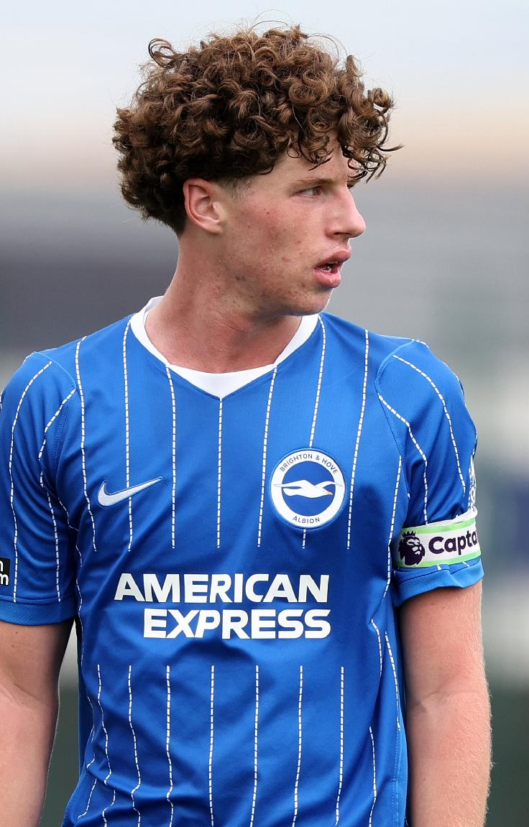
Addressing issues & concerns
Contact host family coordinator
Escalate to Designated Safeguarding Officer
Emergency: 999
Non-emergency: QR Code reporting

Slide 39
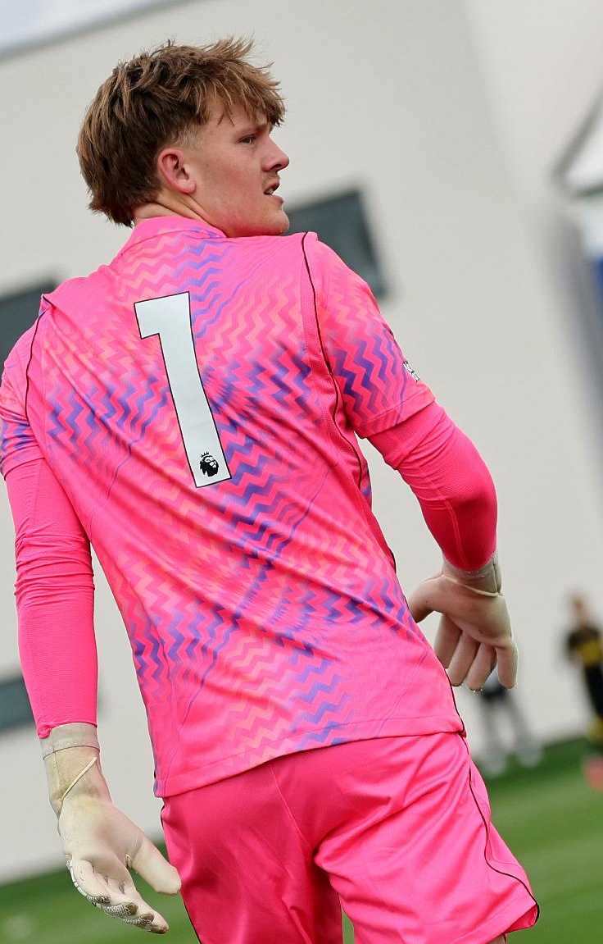
Children first, players second.
We host elite young athletes aiming for top leagues and international representation, but their safety and wellbeing always come first. Our accommodation standards follow government legislation, regulatory guidance, and best practices for young people living away from home.

Slide 40

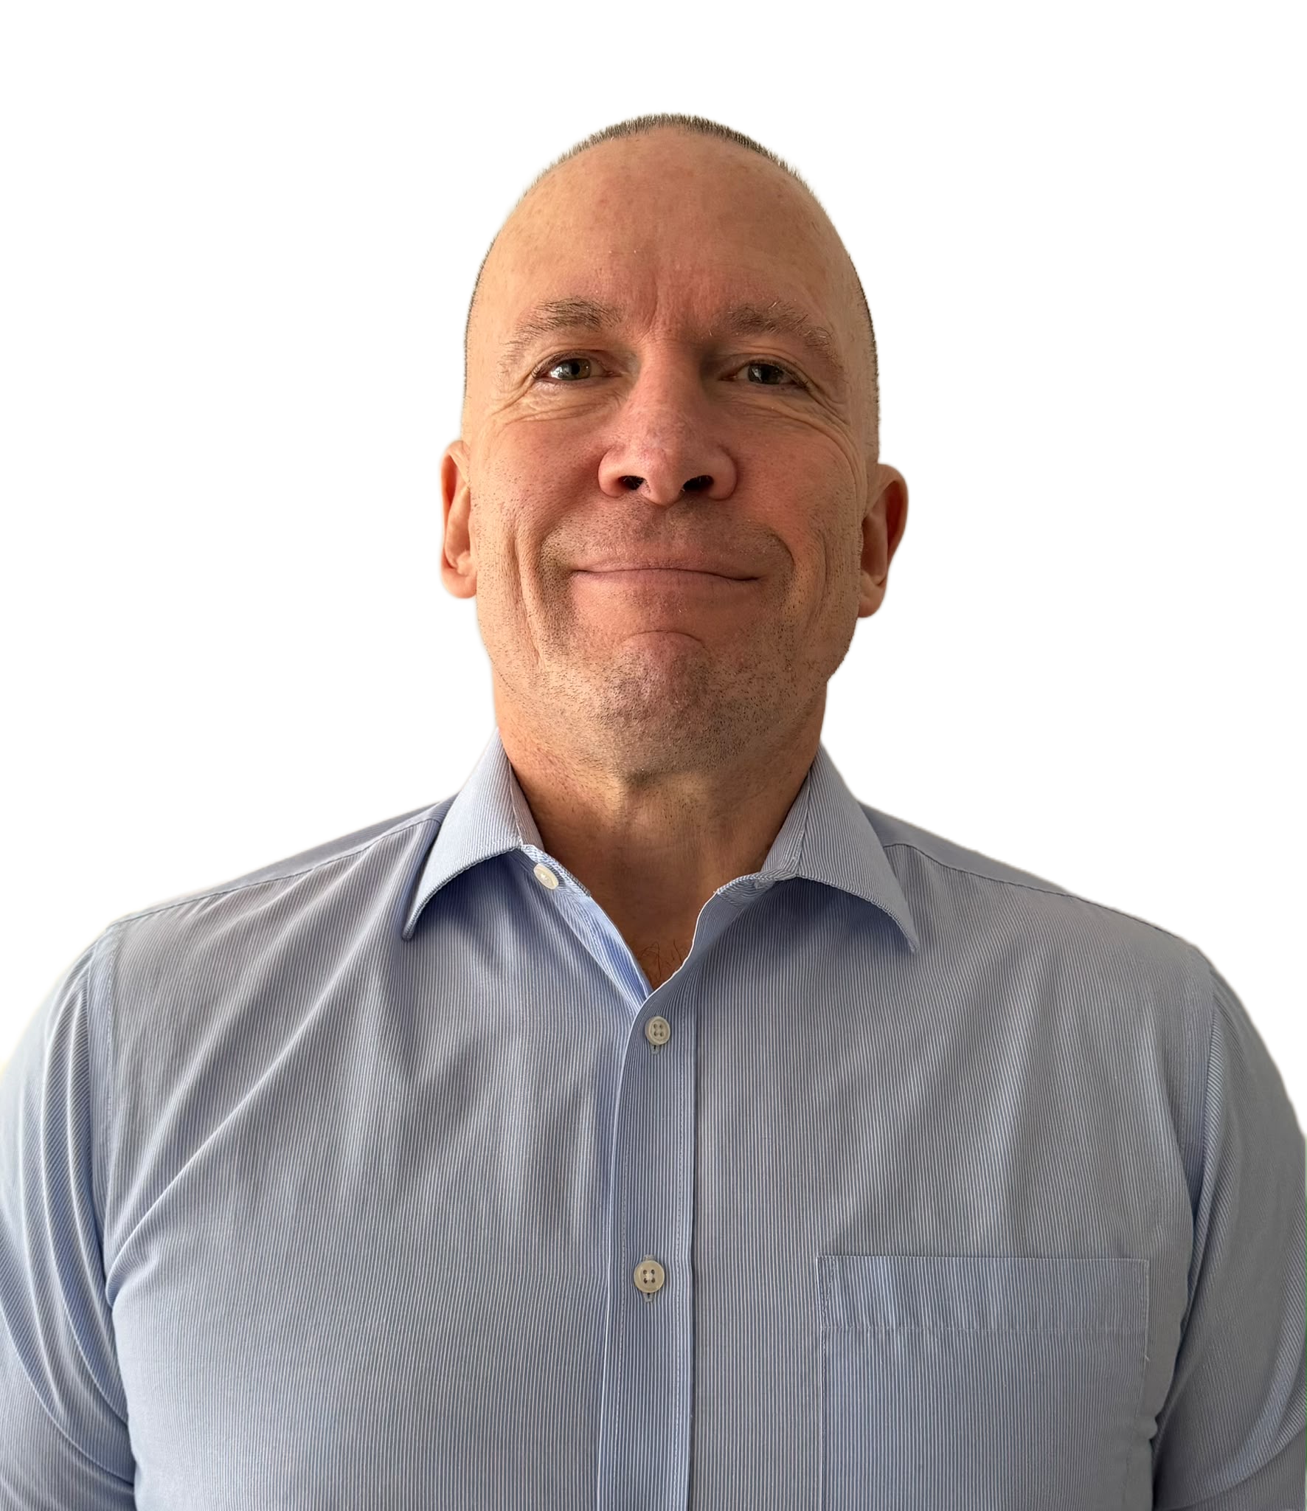
Q&A
Annika Lewis
Host Family Coordinator
Paul Gardener
Host

Slide 42
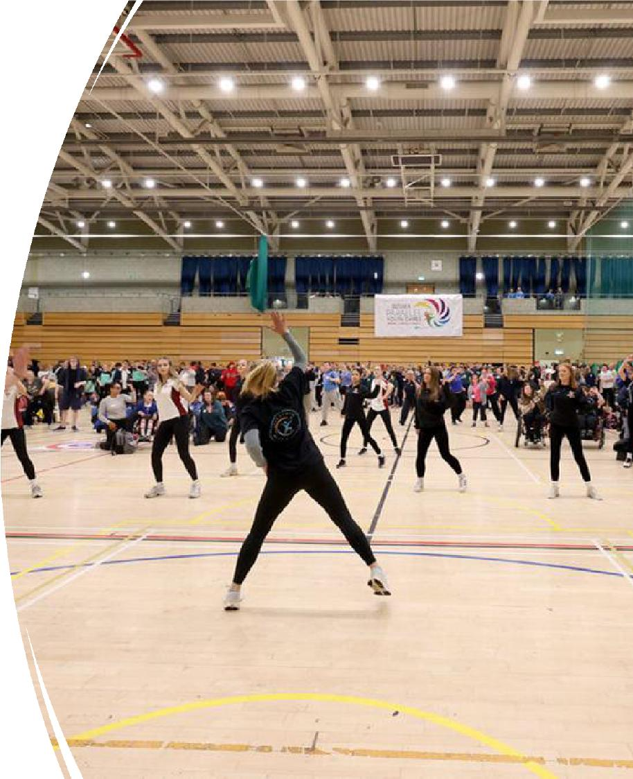

Learning from Emerging Safeguarding Themes in Sport and Physical Activity

Slide 43

Introductions
Active Sussex Learning Agreement
We are creating a safe, supportive space where everyone can
learn and contribute in a way that works for them.
Gemma Finlay-Gray
Active Sussex
Strategic Relationship Manager Email Me
LinkedIn Profile
Be kind and respectful: Value different backgrounds and
perspectives and treat everyone with empathy.
Listen with curiosity: Ask questions to understand, and
challenge ideas without making assumptions.
Share and make space: Contribute your experiences, but
step back so others can be heard.
Participate your way: Engage as you feel comfortable - it
is always fine to pass, pause, or take a break.
Keep stories private: Share the lessons, not people’s
names or personal details. Safeguarding issues must
always be reported properly.
Turn learning into action: Focus on how you can use
what you learn to make a positive impact.
Nick Chellel
Active Sussex
Strategic Workforce Officer Email Me
LinkedIn Profile
#GettingSussexMoving

Slide 44

Active Sussex- Who are we?
Active Sussex is the Active Partnership for Sussex
1/42 nationally.
Funded by Sport England to promote sport and
physical activity across Sussex.
Strategic organisation focused on reducing physical
inactivity and tackling inequalities in Sussex.
Transforming lives
and improving
communities
through sport &
physical activity
Our aim is to is to address inequality and empower
everyone to be active in a way that works for them.
#GettingSussexMoving

Slide 45

Learning Objectives
By the end of the workshop, participants will have:
Explored emerging safeguarding concerns from
Sussex and what they reveal about risk, culture,
professional boundaries and power.
Identified one action to take from the session to
strengthen safeguarding practice within sport and
physical activity.
#GettingSussexMoving

Slide 46

Pairs discussion
What makes safeguarding in sport
and physical activity distinctive or
challenging in your work?
When managing allegations
involving sport or physical activity,
what has helped or complicated
your work?
#GettingSussexMoving

Slide 47

What we are seeing in Sussex
Greater visibility: Previously, contact mainly involved policies,
procedures and training. SWO relationships with clubs and
providers are bringing more concerns to our attention.
Everyday practice and blurred boundaries: Concerns often relate
to coaching behaviour and unclear professional boundaries
around communication, transport and relationships beyond
sessions.
Barriers to challenge: Cultures, loyalty, normalised behaviour and
uncertainty about reporting can make concerns difficult to raise.
Concerns handled in isolation: Some are addressed informally,
with limited recording or review of repeated behaviour.
#GettingSussexMoving

Slide 48
Themes and key learnings
Great coaching supports safeguarding: “Children first, athletes second.” Know and understand participants, listen
to their voices and offer meaningful choice. Positive interactions build trust, wellbeing and belonging.
Boundaries, power and influence matter: Paid and volunteer coaches carry professional responsibilities. Clear
codes of practice and conduct—and challenging harmful coaching norms—help keep relationships safe.
Be curious and act early: Notice changes, listen without assumptions and report concerns through agreed
procedures. Respond to and review lower-level concerns so patterns are recognised.
Build protective environments: Inclusive cultures and spaces, supportive relationships, mentoring, skilled staff
and clear reporting routes strengthen safeguarding. Bespoke support helps clubs improve practice, including
where investigation thresholds are not met.
Share learning to improve practice: Themes inform local support and are shared through the national SWO
network and Lead Safeguarding Officer forums.
Our proactive response: Sussex Safeguarding in Sport Forum, Sport Welfare Officer support, and the July Child
First Coaching & Proactive Safeguarding: Building Positive Cultures Together Community of Learning.
#GettingSussexMoving

Slide 49

Scenarios Discussion
A two-way exchange: Bring your LADO expertise to the emerging
challenges we are seeing in sport and physical activity.
Work in small groups: Two groups will explore the regulated activity
scenario; two will explore the unregulated activity scenario.
Explore two stages: Discuss the initial concern, then consider how
further information changes your understanding and response.
Share your approaches: Explore thresholds, professional boundaries,
information sharing and responsibilities across organisations.
Identify learning: Agree key insights, gaps and practical messages to
feed back to NGBs, Active Partnerships and Sport Welfare Officers.
Feedback together: Share your key discussion points and learning
with the rest of the group.
#GettingSussexMoving

Slide 50

Stage 1 discussion questions
What makes this scenario complex from a LADO
perspective regarding thresholds, NGB
involvement, or information sharing protocols
Why might a club, welfare officer, or provider fail
to report these early boundary concerns to an
NGB or LADO?
How would you navigate the tension between
managing statutory risk and supporting non-
statutory/unregulated sports providers?
#GettingSussexMoving

Slide 51
Stage 2 discussion questions
Why do isolated 'lower-level' boundary
concerns frequently fail to trigger threshold
decisions until a major allegation occurs?
What tools or levers do LADOs have when a
coach operates privately or an affiliated club
refuses to engage?
What key message or gap from this scenario
should Active Sussex and SWOs feed back to
NGBs and Active Partnerships?
#GettingSussexMoving

Slide 52
Scenario A: stage 1
A community sports club runs sessions for children aged 12–17. A longstanding volunteer
coach is highly regarded and has helped several young people progress.
A parent tells the welfare officer that their 14-year-old no longer wants to attend. The child
says the coach singles them out and makes comments about their commitment in front of
the group.
Another volunteer has noticed the coach messaging individual young people through a
personal account and sometimes offering lifts home.
The chair says the coach ‘goes above and beyond’ and suggests resolving the matter
informally. The welfare officer is relatively new and knows the coach socially.
#GettingSussexMoving

Slide 53
Scenario A: stage 2
The welfare officer discovers two earlier concerns about the coach’s language. These were
handled verbally and were not brought together.
Another young person says the coach tells them that ‘serious athletes don’t complain’ and
worries that raising concerns could affect selection. The coach also works at another activity
provider.
The club is affiliated to an NGB, but its safeguarding team has not been contacted. The chair
asks the welfare officer to wait until after an upcoming competition before taking further
action.
#GettingSussexMoving

Slide 54
Scenario B: stage 1
A Local Authority commissions a regional Partnership Organisation to oversee and fund a
local youth activity programme. The Partnership undertakes due diligence and allocates grant
funding to local delivery providers, many operating in unregulated settings without NGB
governance.
A parent tells the welfare officer at one of the funded ‘unregulated’ providers that their 14-
year-old no longer wants to attend, reporting that the head coach singles them out, criticises
their commitment, and routinely messages them late at night offering private coaching and
lifts home.
The LADO receives this concern and asks the Partnership to investigate and decide on
funding, but citing data protection protocols, the LADO shares no specific details about the
behaviour or disclosure. The Partnership feels unable to make an informed funding decision,
and Children's Services are unclear who holds operational responsibility for immediate risk.
#GettingSussexMoving

Slide 55
Scenario B: stage 2
The welfare officer discovers two earlier written complaints regarding the coach’s inappropriate
language and boundary crossing. These were handled verbally by the provider's manager, stored
in separate personnel files, and never centrally recorded or reported to the LADO/Partnership.
Another young person discloses the coach says "serious athletes don't complain" fearing raising
concerns will affect participation. Furthermore, the LADO receives information from an NGB (via
Police) regarding a serious allegation against the coach at another venue.
Learning from earlier communication gaps, the LADO coordinates a Transfer of Risk (ToR)
assessment with Children's Services. During this process, it emerges the coach—suspended by
the NGB—has continued coaching young people privately in unregulated settings. An affiliated
club linked to the provider initially refuses to engage, but updates its practices after supportive
outreach from a Sports Welfare Officer (SWO).
#GettingSussexMoving

Slide 56

Reflections and next steps
With the person next to you, discuss
and reflect on:
One key learning I am taking away
One question I will ask differently
or one action I will take
#GettingSussexMoving

Slide 57
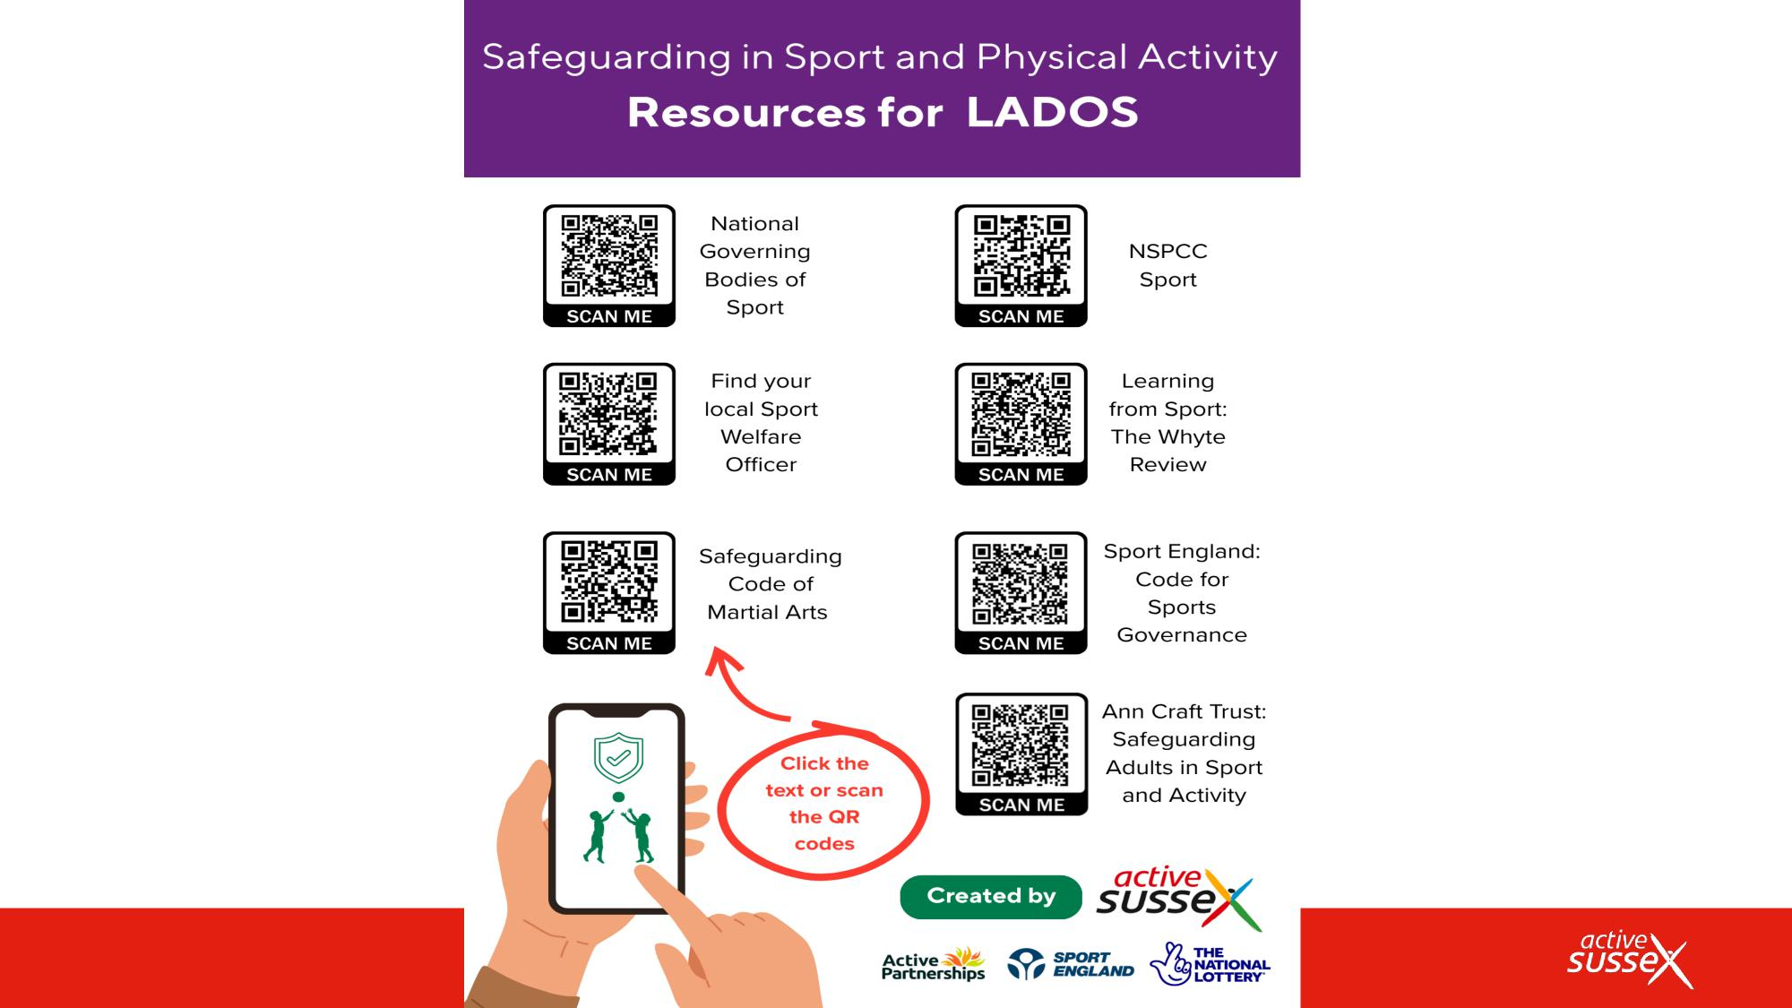
Resource
#GettingSussexMoving

Slide 58
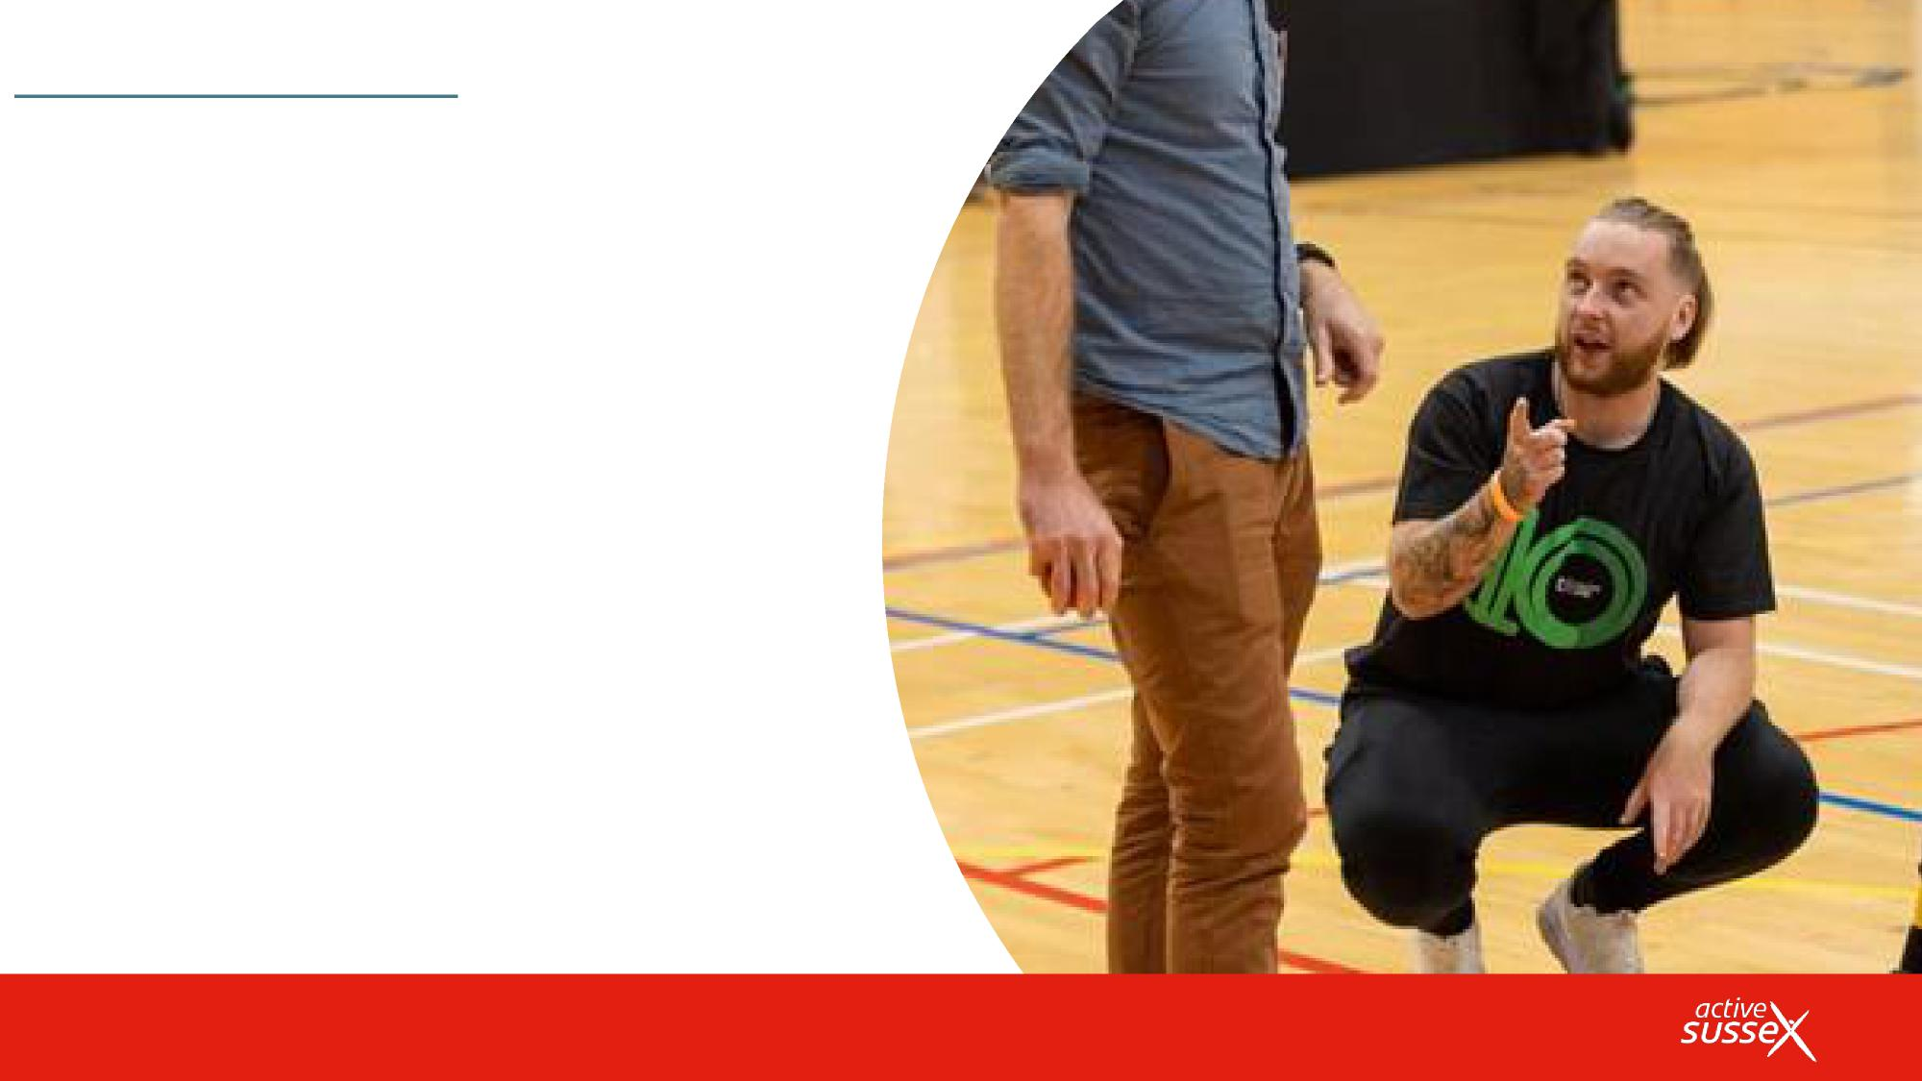
Sign up to our newslettersto keep up-to-date with all the
news and funding opportunities.
Questions or
further advice/support?
#GettingSussexMoving

